Slide 1
Re-analysis of monkey behavioural data on final version of Koechlin task

Slide 2
Background
Filipowicz, Domenech et al have interesting data from AI lesioned patients with the human ”Koechlin task”
In particular they dissociate “Good” and “Bad” learners
Bad learners appeared to reset parts of their beliefs after –ve feedback
In particular they showed a striking effect following “Negative traps” (in the manuscripts this is Traps on correctly responded trials that therefore gained –ve FB).
This reset was the case regardless of how much they had been recently rewarded for choices on that stimulus
In the paper they link the poor learning to a lesion overlap in the AI
PD proposes a hypothesis that monkeys may, in some cases, be like poor learners in the human expt.
There is the potential, if this is the case, that we can say something interesting about AI across species and the role of the AI in this system, for example in its role in the implementation of shifts and resets

Slide 3
Aim
The aim here is to essentially recapitulate Fig2 from the manuscript, but in monkeys
Data used is from when they are performing the task as closely to the humans as possible.
The first question we will ask is: Do monkeys look like good or bad learners?

Slide 4
Notes on monkey task
2 stimuli in a problem, and 3 response boxes
Other contingencies are similar. Haven’t compared episode lengths but should do if we go further
2 monkeys: Dali & Pippa
Very well trained on this task (>18 months at time of data used)
Progressive training regime (see Faraut et al L&M 2016)
Might be worth also looking at earlier stages in the training if their learning is “too” good
Analysis of data from 66 sessions for Dali and 101 sessions for Pippa
500-1000 trails per session
Figures
In each case, human fig from manuscript on left, then Dali, then Pippa

Slide 5
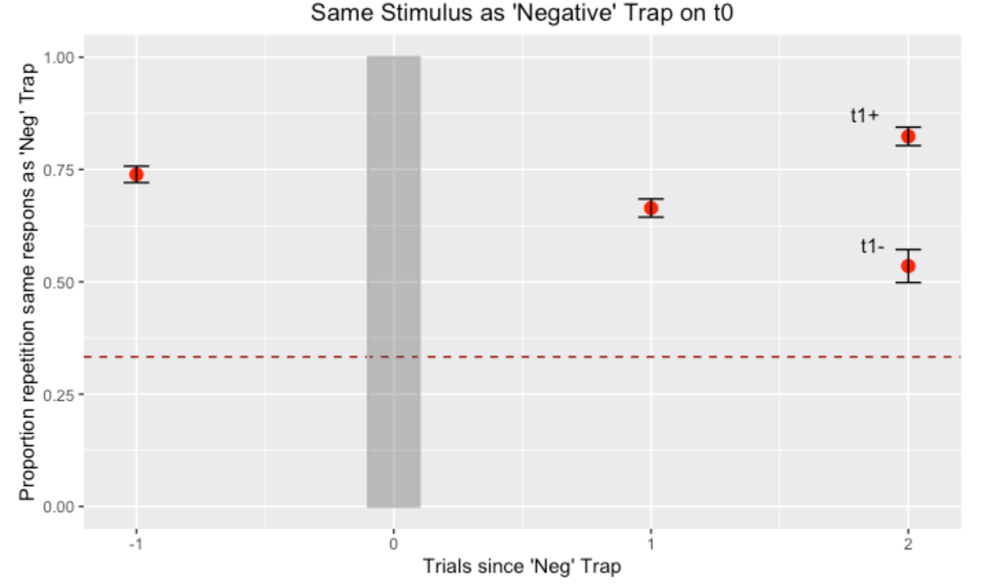
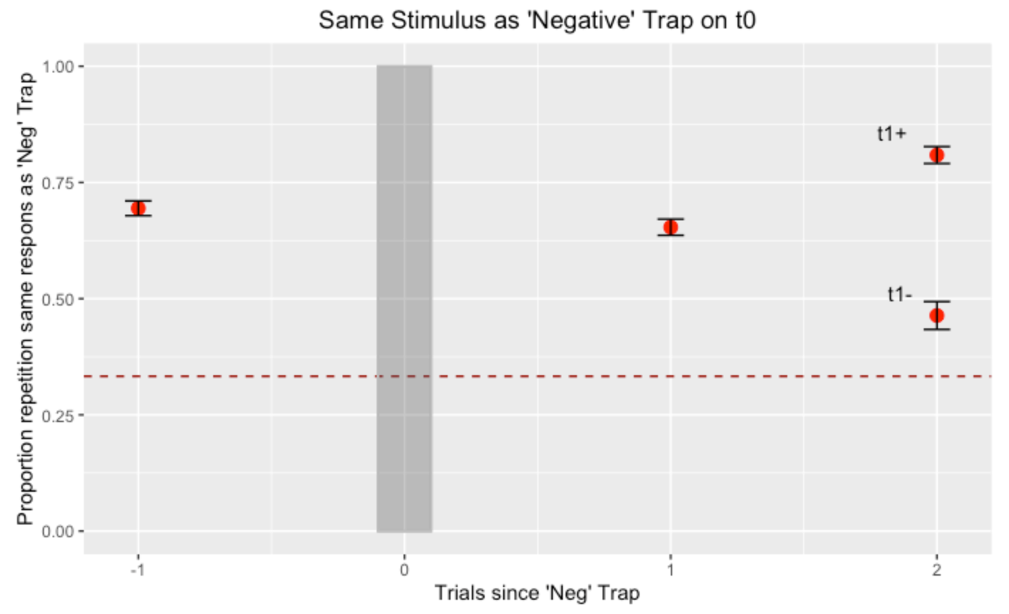
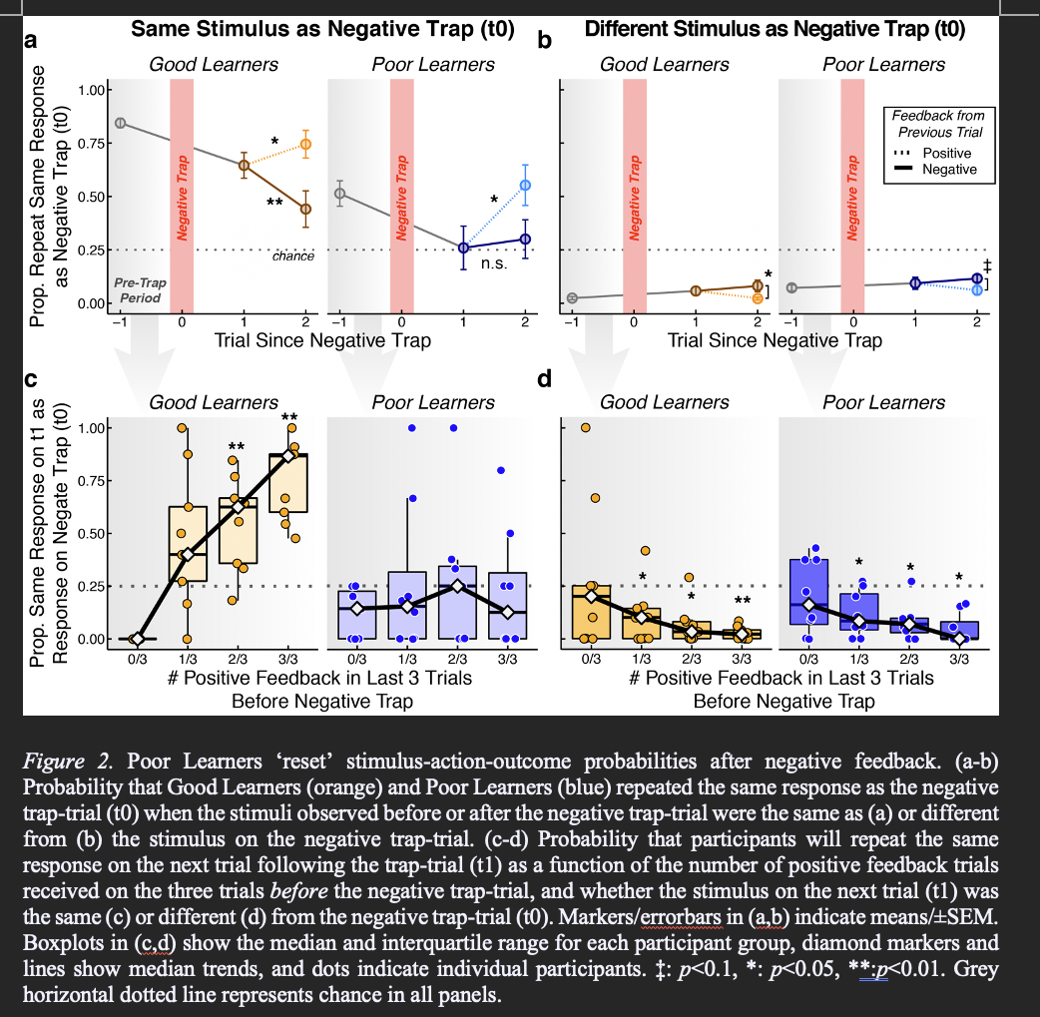
Fig 2a

Slide 6
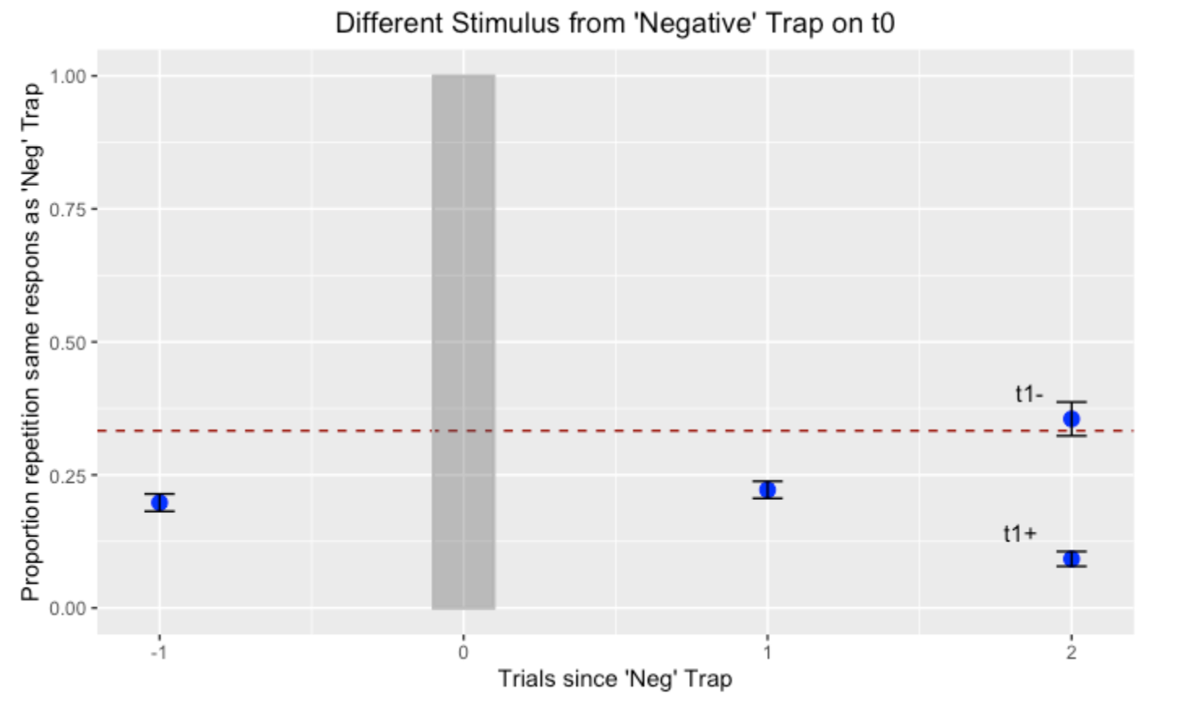
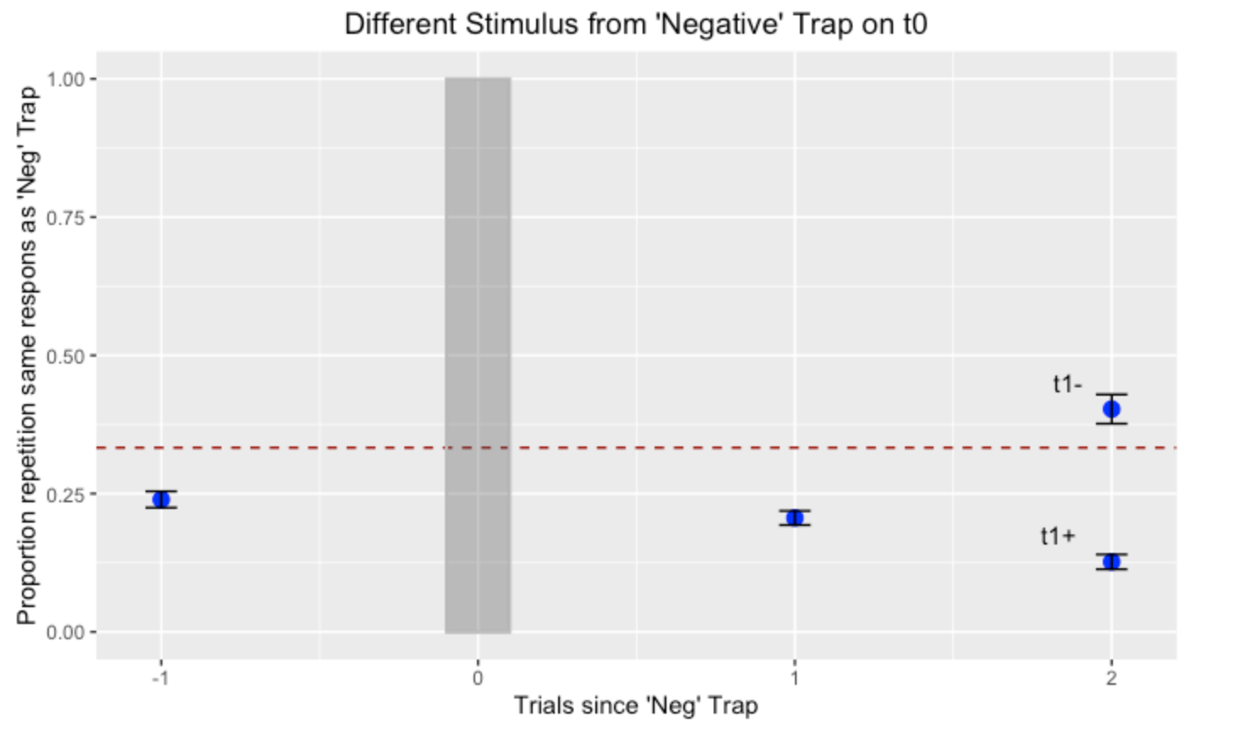
Fig 2b

Slide 7
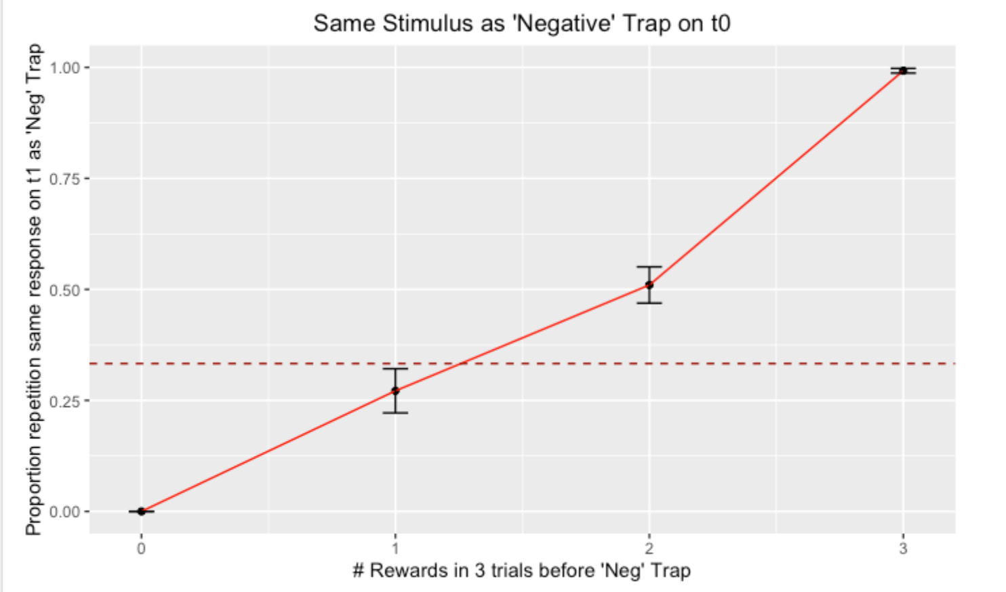
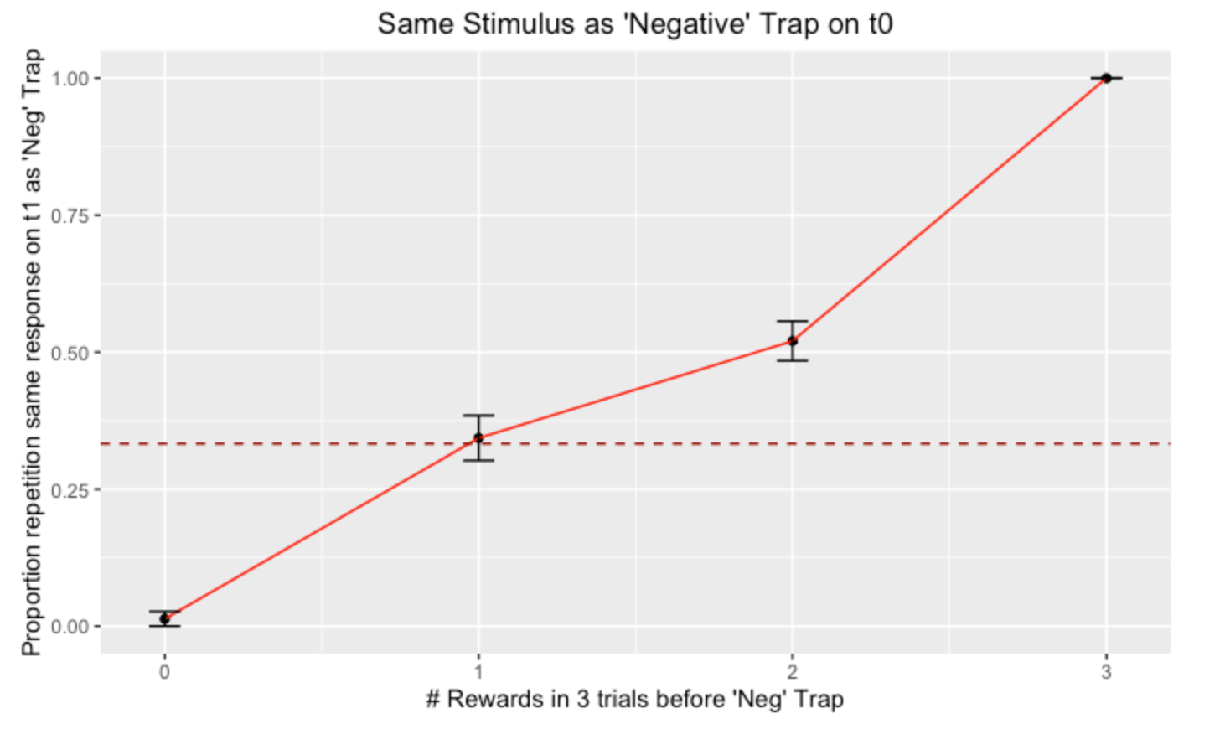
Fig 2c

Slide 8
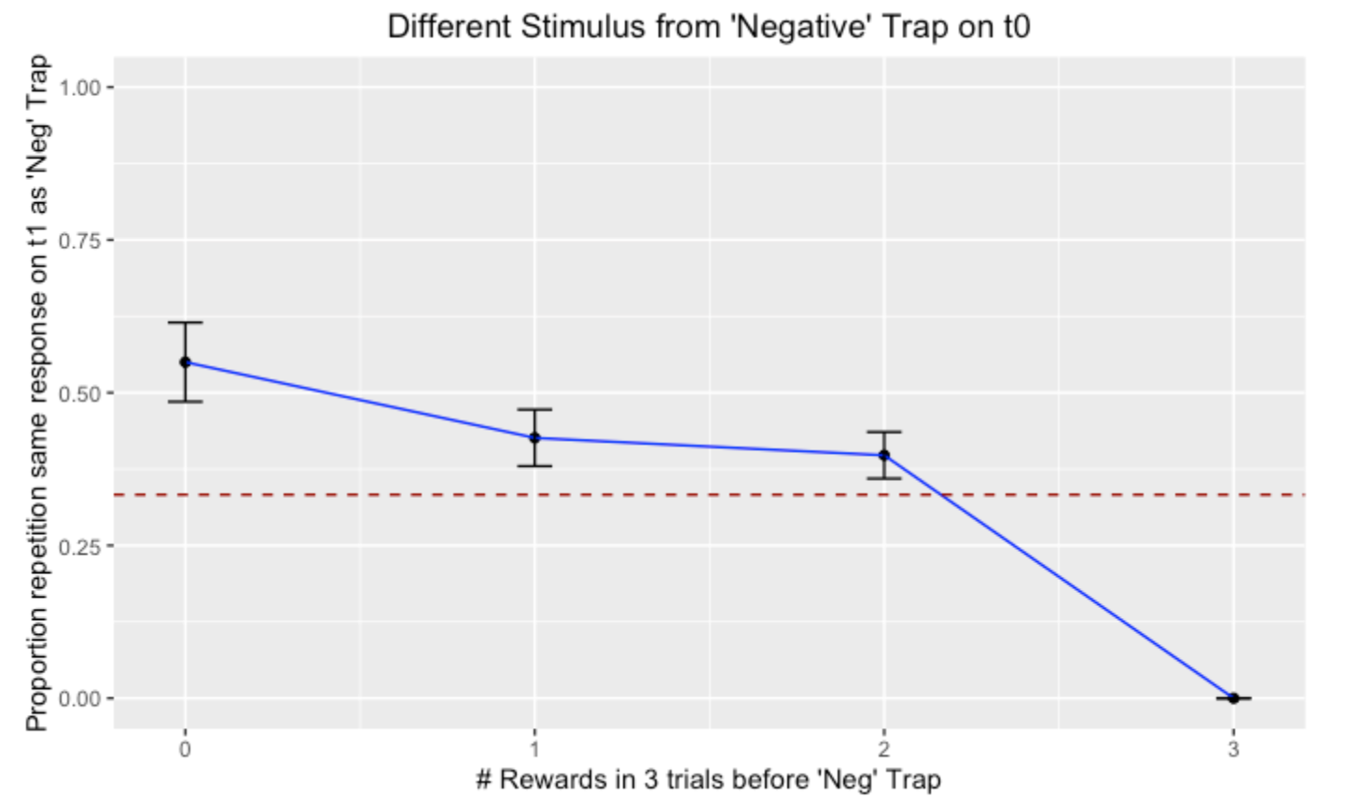
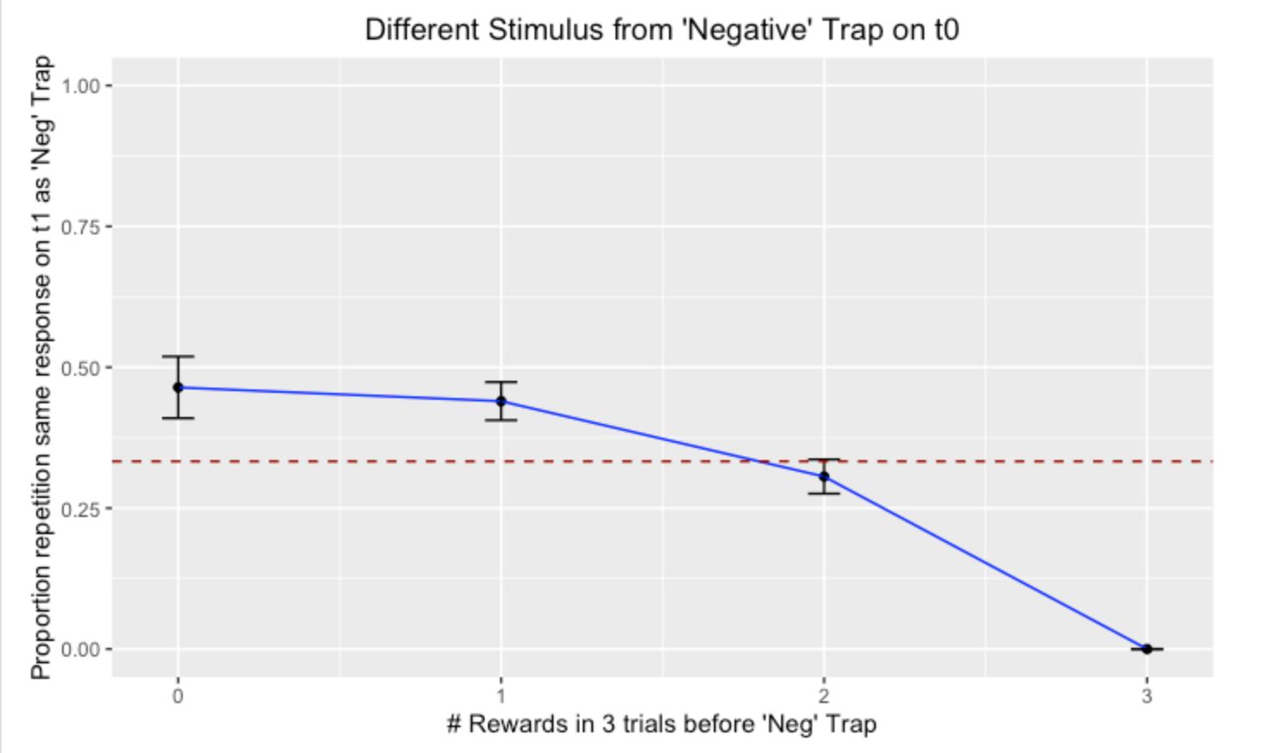
Fig 2d

Slide 9
Thoughts
The monkeys look like good learners
They are also *very* over-trained at this stage, is it worth looking earlier in the protocol?
Monkeys also have Von Economo neurons 😉

